Slide 1

NODE JS
Aruna S
Department of
Computer Science and Engineering

Slide 2

NODE JS
HTTP Module
S. Aruna
Department of Computer Science and Engineering

Slide 3
NODE JS
Web Server
A Web Server is a software application which handles HTTP requests sent by the HTTP client, like web browsers, and returns web pages in response to the clients.
Web servers usually deliver html documents along with images, style sheets, and scripts.
Most of the web servers support server-side scripts, using scripting languages or redirecting the task to an application server which retrieves data from a database and performs complex logic and then sends a result to the HTTP client through the Web server.
Apache web server is one of the most commonly used web servers. It is an open source project.

Slide 4
NODE JS
Web Application Architecture
A Web application is usually divided into four layers −
Client − This layer consists of web browsers, mobile browsers or applications which can make HTTP requests to the web server.
Server − This layer has the Web server which can intercept the requests made by the clients and pass them the response.
Business − This layer contains the application server which is utilized by the web server to do the required processing. This layer interacts with the data layer via the database or some external programs.
Data − This layer contains the databases or any other source of data.

Slide 5
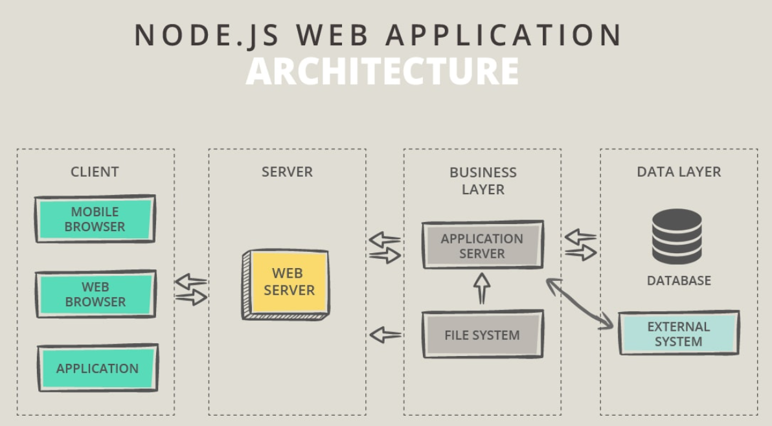
NODE JS
Web Application Architecture

Slide 6

NODE JS
HTTP Module – Web Server using Node
The components of a Node.js application.
Import required modules − We use the require directive to load Node.js modules.
Create server − A server which will listen to client's requests similar to Apache HTTP Server. Node.js has a built-in module called HTTP, which allows Node.js to transfer data over the Hyper Text Transfer Protocol (HTTP).
Read request and return response − The server created in an earlier step will read the HTTP request made by the client which can be a browser or a console and return the response.
Creating Node.js Application
Step 1 - Import Required Module
We use the require directive to load the http module and store the returned HTTP instance into an http variable as follows

Slide 7
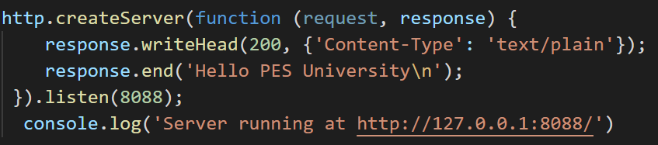
NODE JS
HTTP Module
Step 2 - Create Server
We use the created http instance and call http.createServer() method to create a server instance.
Then we bind it at port 8088 using the listen method associated with the server instance.
Step 3 - Testing Request & Response
$node app.js
Verify the Output. Server has started.
Server running at http://127.0.0.1:8088/

Slide 8

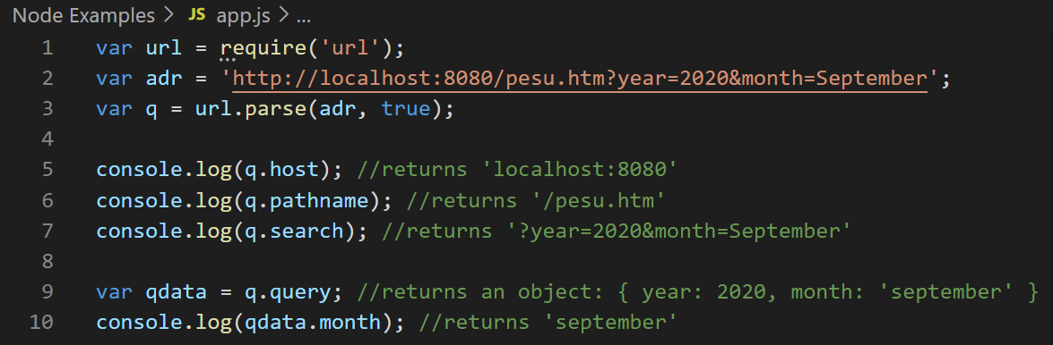
NODE JS
URL Module
The URL module splits up a web address into readable parts.
To include the URL module, use the require() method:
Parse an address with the url.parse() method, and it will return a URL object with each part of the address as properties:

Slide 9
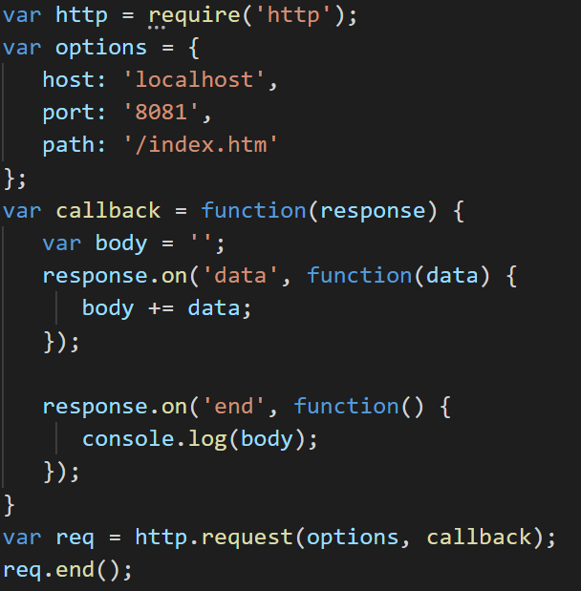
NODE JS
Web Client Using Node
A web client can be created using http module. A Screenshot of the example is below

Slide 10
NODE JS
Node JS and MongoDB Connectivity
Node.js can be used in database applications.
One of the most popular NoSQL database is MongoDB.
Download a free MongoDB database at https://www.mongodb.com.
Node.js can use this module to manipulate MongoDB databases
require(‘mongodb’);
Creating a Database
To create a database in MongoDB, start by creating a MongoClient object, then specify a connection URL with the correct ip address and the name of the database.
MongoDB will create the database if it does not exist, and make a connection to it.

Slide 11
NODE JS
Node JS and MongoDB Connectivity
Creating a Collection
To create a collection in MongoDB, use the Collection() method
In MongoDB, a collection is not created until it gets content.
Insert a single document Into Collection
To insert a record, or document as it is called in MongoDB, into a collection, use the insertOne() method.
A document in MongoDB is the same as a record in MySQL
The first parameter of the insertOne() method is an object containing the name(s) and value(s) of each field in the document you want to insert.
It also takes a callback function where you can work with any errors, or the result of the insertion

Slide 12
NODE JS
Node JS and MongoDB Connectivity
Select the documents from collection:
In MongoDB use the find and findOne methods to find data in a collection.
Just like the SELECT statement is used to find data in a table in a MySQL database.
Find:
To select data from a table in MongoDB, we can also use the find() method.
The find() method returns all occurrences in the selection.
The first parameter of the find() method is a query object.

Slide 13
THANK YOU
Aruna S
Department of
Computer Science and Engineering
arunas@pes.edu

